Slide 1
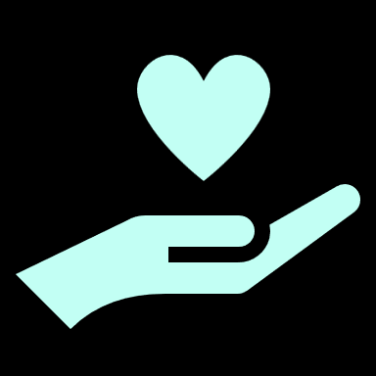
The differeneces in physiotherapy methods & approaches
Klára Voráčková Jarkko Lappalainen Fani Karageorgou
Kateřina Hrušková Ioakeim Lalas

Slide 2
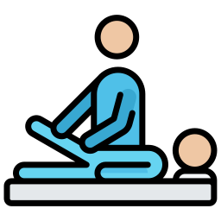
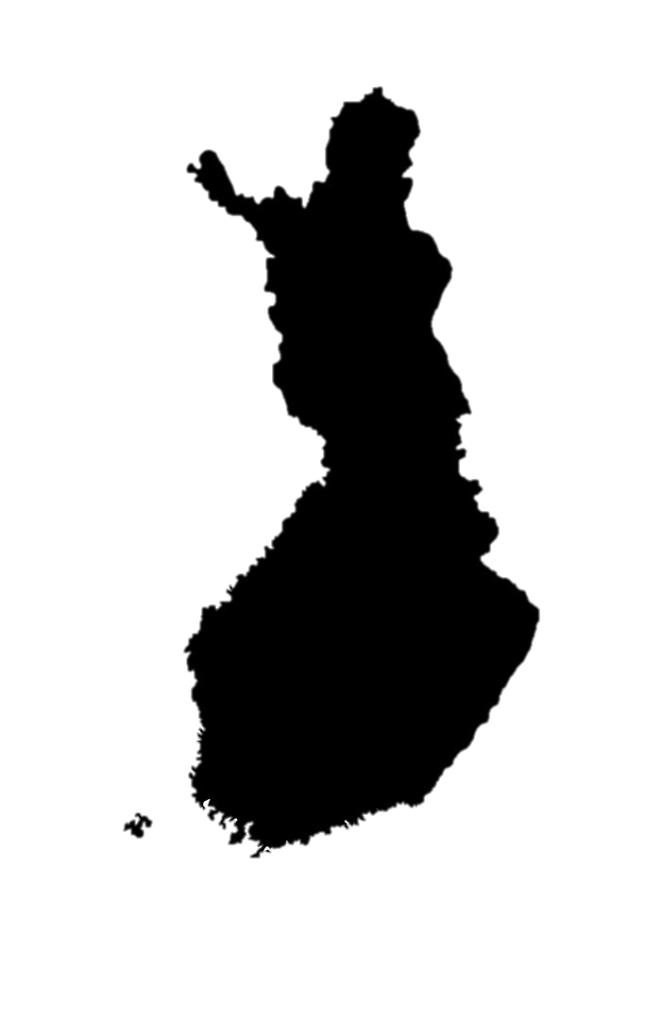
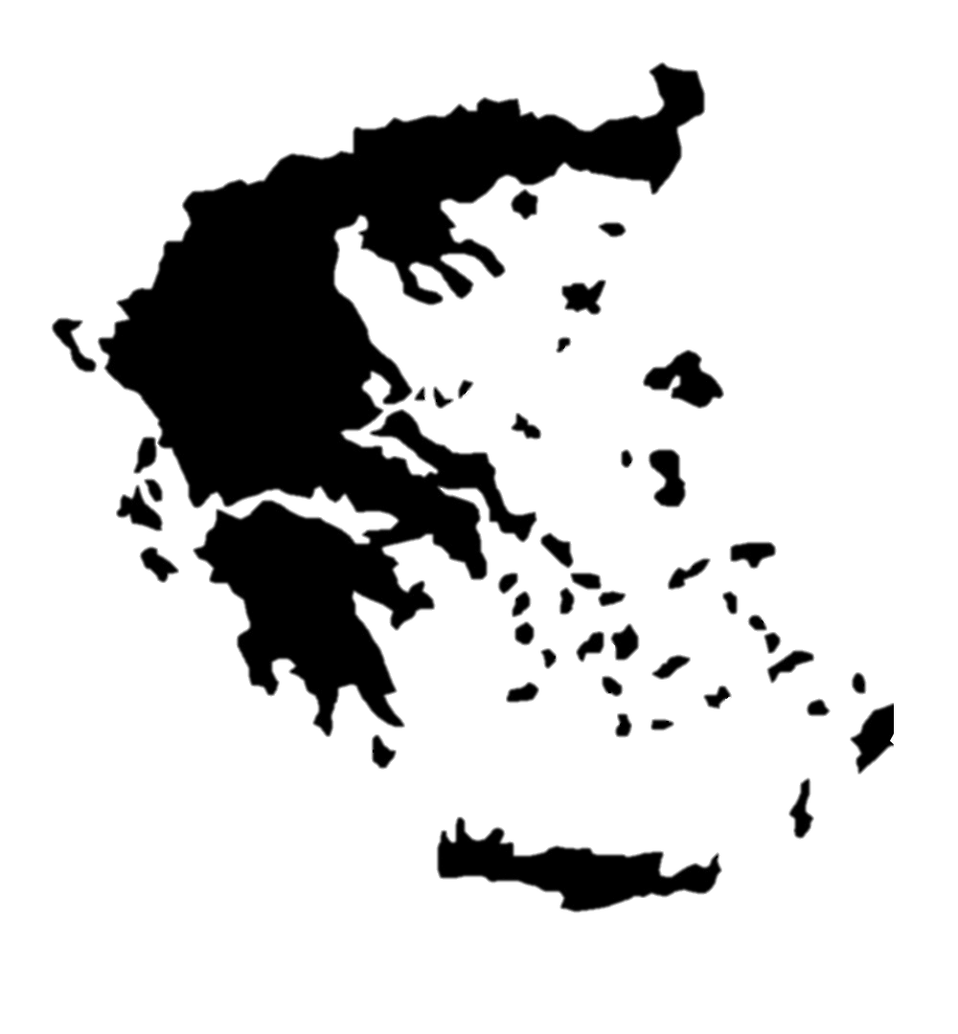
The physiotherapeutic approaches
Finland
Greece
The most common is hands on approach
Czechia
Hands-on, focus on manual medicine, exercising is getting more popular
Biopsychosocial approach is highly recommended
Try to involve the patient’s family in the rehabilitation programs
Emphasis on the biopsychosocial model
Participation in group rehabilitation programs
Public sector is more hands-off
Private sctor is more hands-on
Biopsychosocial approach
Cognitive-behavioral approach
Similar in both public and private sector
More individual therapies but also group programs
Teach about: pain management coping mechanisms
Notes:
therapy and its goals are planned with the patient and with the patient’s wants in mind. The therapist doesn’t get to have the final say about goals and such; the patient does. The therapist is there to guide and help the patient.
With children, depending if you are in a hospital or a healthcare center there might be some protocols to follow. The therapist is there to guide the parent(s). You have to remember that the child is still developing.
Coming up with different kind of plays and games in therapy is normal when working with children.
Vojta is not commonly used in Finland.
Bobath is more common in Finland.
Health care is divided in public sector and private sector
Patient lifts are common. VR is becoming more and more used, as are other types of games.
High end robotics are expensive and not very common. A few larger hospitals have some walker robots along with some private sector physiotherapists. Walker robots can cost over 100k €
Massages are not done in the public sector.
Physiotherapy in the public sector is shifting towards making the patient be more active themselves; hands-on methods aren’t that popular any more.
Some patient groups still need hands-on methods i.e. people with the MS-disease, late stage ALS etc. PNF is used.
Cognitive-behavioral therapy methods are on the rise. Teaching the patient about pain, pain management and coping mechanisms for pain are seen as important; finding ways to reduce fear and stress related to pain.
In the private sector you can have fascial manipulations, massages, dry needling etc.
Mobilisations are done depending on the physiotherapist and their skills.
TENS, ultrasound, thermotherapy etc. are sometimes used, with TENS being the most common.
People are seen as biopsychosocial beings and you have to treat every aspect of the word:
bio - medications, musculoskeletal entirety etc.
psycho - how is the patient feeling? stress, fears etc. ?
social - does the patient have family to help them? Do they have another support group, besides from the family? etc.
The predominant physiotherapy method for neurological patients in Greece is hands-on therapy. Establishing a strong connection with the patient through physical touch from the initial session is crucial for Greek physiotherapists. This approach enables them to better perceive body abnormalities like muscle spasticity or atrophy, assist patient’s muscle contraction, identify mistakes during the exercise execution, correct them at the same time, and earn their trust, promoting a sense of safety for the patient. Additionally, we try to involve the patient's family members in the rehabilitation program and provide them with proper guidance. Last but not least it is often suggested that neurological patients participate in group rehabilitation programmes as they gain motivation and they have the chance to socialize with other people, something that is often considered to be difficult for them. This is considered important especially within the framework of the biopsychosocial model which plays a significant role in our clinical reasoning.

Slide 3
Commonly used methods and “national” methods in Physiotherapy
Finland
Greece
Neurological: Bobath, PNF, Hydrotherapy and specifically Halliwick method
Czechia
Manual therapy, mobilistions, post isometric rlaxation, fascia therapy
Bobath, PNF
Kaltenborn mobilisation methods
McKenzie
Many methods depend on the therapist and their specializations
NPMP (=Norwegian psychomotor physio)
Musculoskeletal: PNF, Mulligan, Kaltenborn, Maitland, McKenzie, Cyriax, Schroth
Many methods that are used in musculoskeletal physio are also used in neurological patients as many of them have musculoskeletal problems
Vojta, DNS, Mojžíšová
PNF, Bobath, McKenzie
Zootherapies especially with children with disabilites
Notes:
In Greece the most common hands on methods of neurological rehabilitation is Bobath and PNF.
Bobath is mainly used for the rehabilitation of children and adults with kinetic dysfunction caused by neurological disorders like cerebral palsy and hemipledgia caused by stroke. Our main aim is to inhibit pathological reflex patterns of posture and
movement and facilitate normal reactions.
PNF is also a very common method used by clinicians in Greece. Our primary goal is for patients to achieve the highest possible level of function. This can be achieved through appropriate guidance of movement with suitable handles and resistance in diagonal movement patterns.

Slide 4
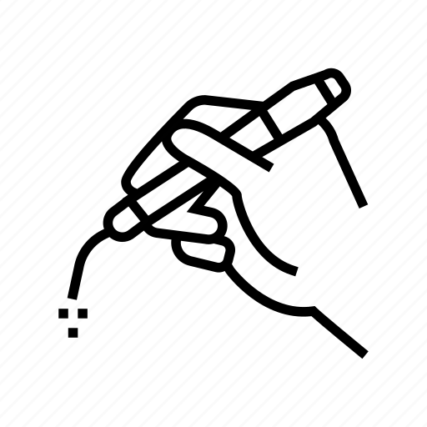
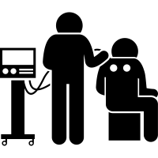
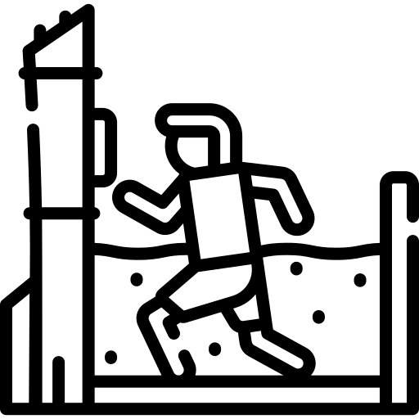
Physical therapy
Finland
Greece
Electrotherapy
Czechia
Electrotherapies
TENS
Thermotherapy
Hydrotherapy
Ultrasound
Massages
Lymphotherapy
especially TENS and EMG Biofeedback
Hydrotherapy
mainly the Halliwick method
Diathermy
Therapeutic ultrasound
Laser therapy
Shockwave therapy
Heat / Cold treatment
(deep heating)
Mechanotherapy
many of them
Magnetotherapy
Hydrotherapy
ultrasound, extracorporeal shock wave
Parafin
Phototherapy
laser, biolamps

Slide 5
Highlights of the week
Prague castle on Thursday
Karlovy Vary and the underground museum of the Thermal Springs
Chats with new people
Charles bridge on Monday
The visit of Beroun hospital
Vojta method in Thomayer hospital
Conference in Beroun
Autopsy room

Slide 6
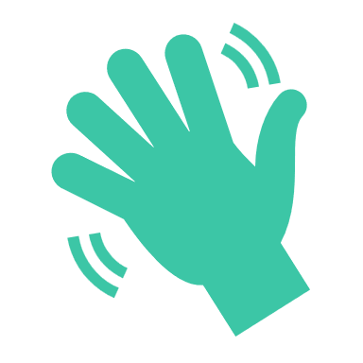
Thank you for your attention and amazing week!
Hopefully see you again.

