Slide 1
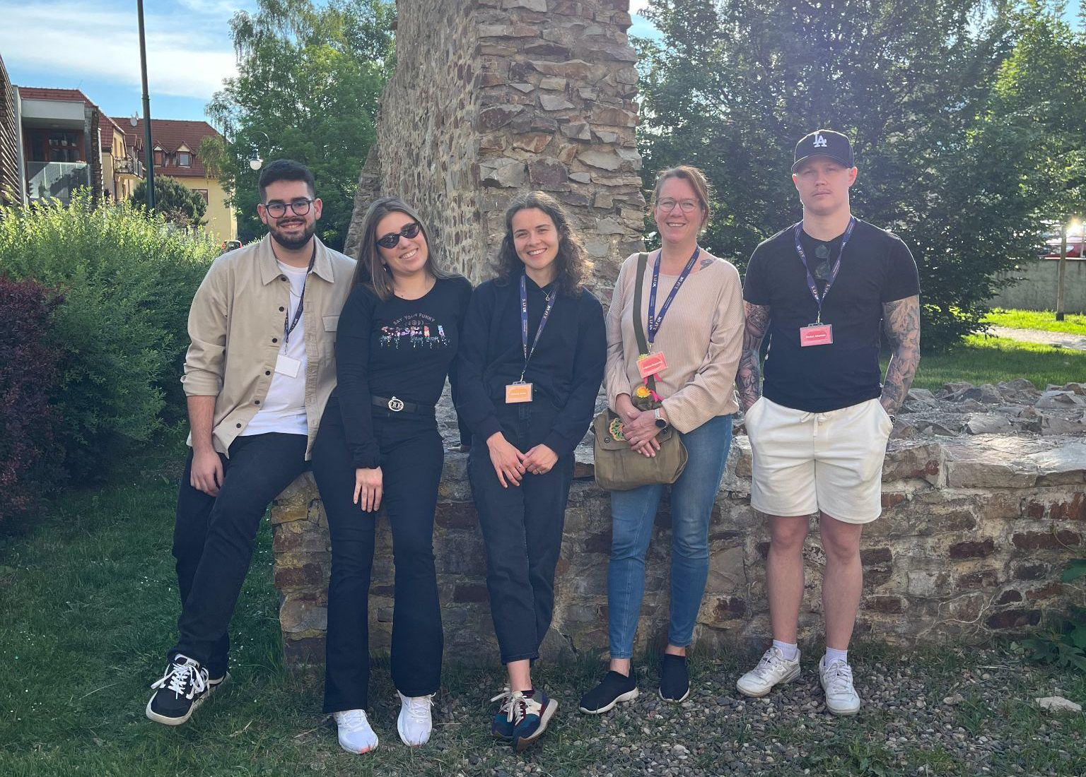
Differences in Bachelor’s studies among our countries
Student’s:
Ahonen Aleksi
Chatziavraam Nikolaos
Feitová Anna
Koritsi Eleni
Koponen Kristiina

Slide 2
Differences in:
How we get in the University | University exams (with interview) | High school exams (Panhellenic exams) | High school exams & University exams
Cost | Free (except books) | Free (everything is free books etc.) | Free (except books)
Scholarships | No | No | No
Years of study | 3 years | 4 years | 3,5 years
Semesters | 6 semesters | 8 semesters | 7 semesters
Students | ~ 35 | ~ 100 | ~ 30-45

Slide 3
Differences in:
Forms of Study | 10 - 12 per semester (theoretical and practical lessons) Practical lessons are mandatory | 6 per semester (split in theory and lab) Lab lessons are mandatory | 6-8 per semester (split in theory and lab) Lab lessons are mandatory
Lesson Chains | No | Yes | No
Clinical Lessons | Yes, from the 3rd semester (8 hours per week) | Yes, from the 4th semester (12 hours per week) | Yes, from 2nd semester (12 hours per week)
Internships | Yes, during semesters and 4 weeks during summer vacation Not getting paid | Yes, in our last semester, 18 weeks in total Get paid | Yes, in between semesters, 28 weeks (+3 +3) Not getting paid
State practice vs Private hospitals | Anywhere | Anywhere | Easier to state practice
Notes:
Czech:
Greece:
In the last semester we have our internship
Lesson chains, some subjects are chained together, so if for example you don’t pass our lesson of Neurorehabilitation then you cant go to the neurology clinic
Our internship can be done at whatever facility we want
6 lessons per semester
We only have high school exams, and the score we get on those, it determines on which university we will go to
Finland:

Slide 4
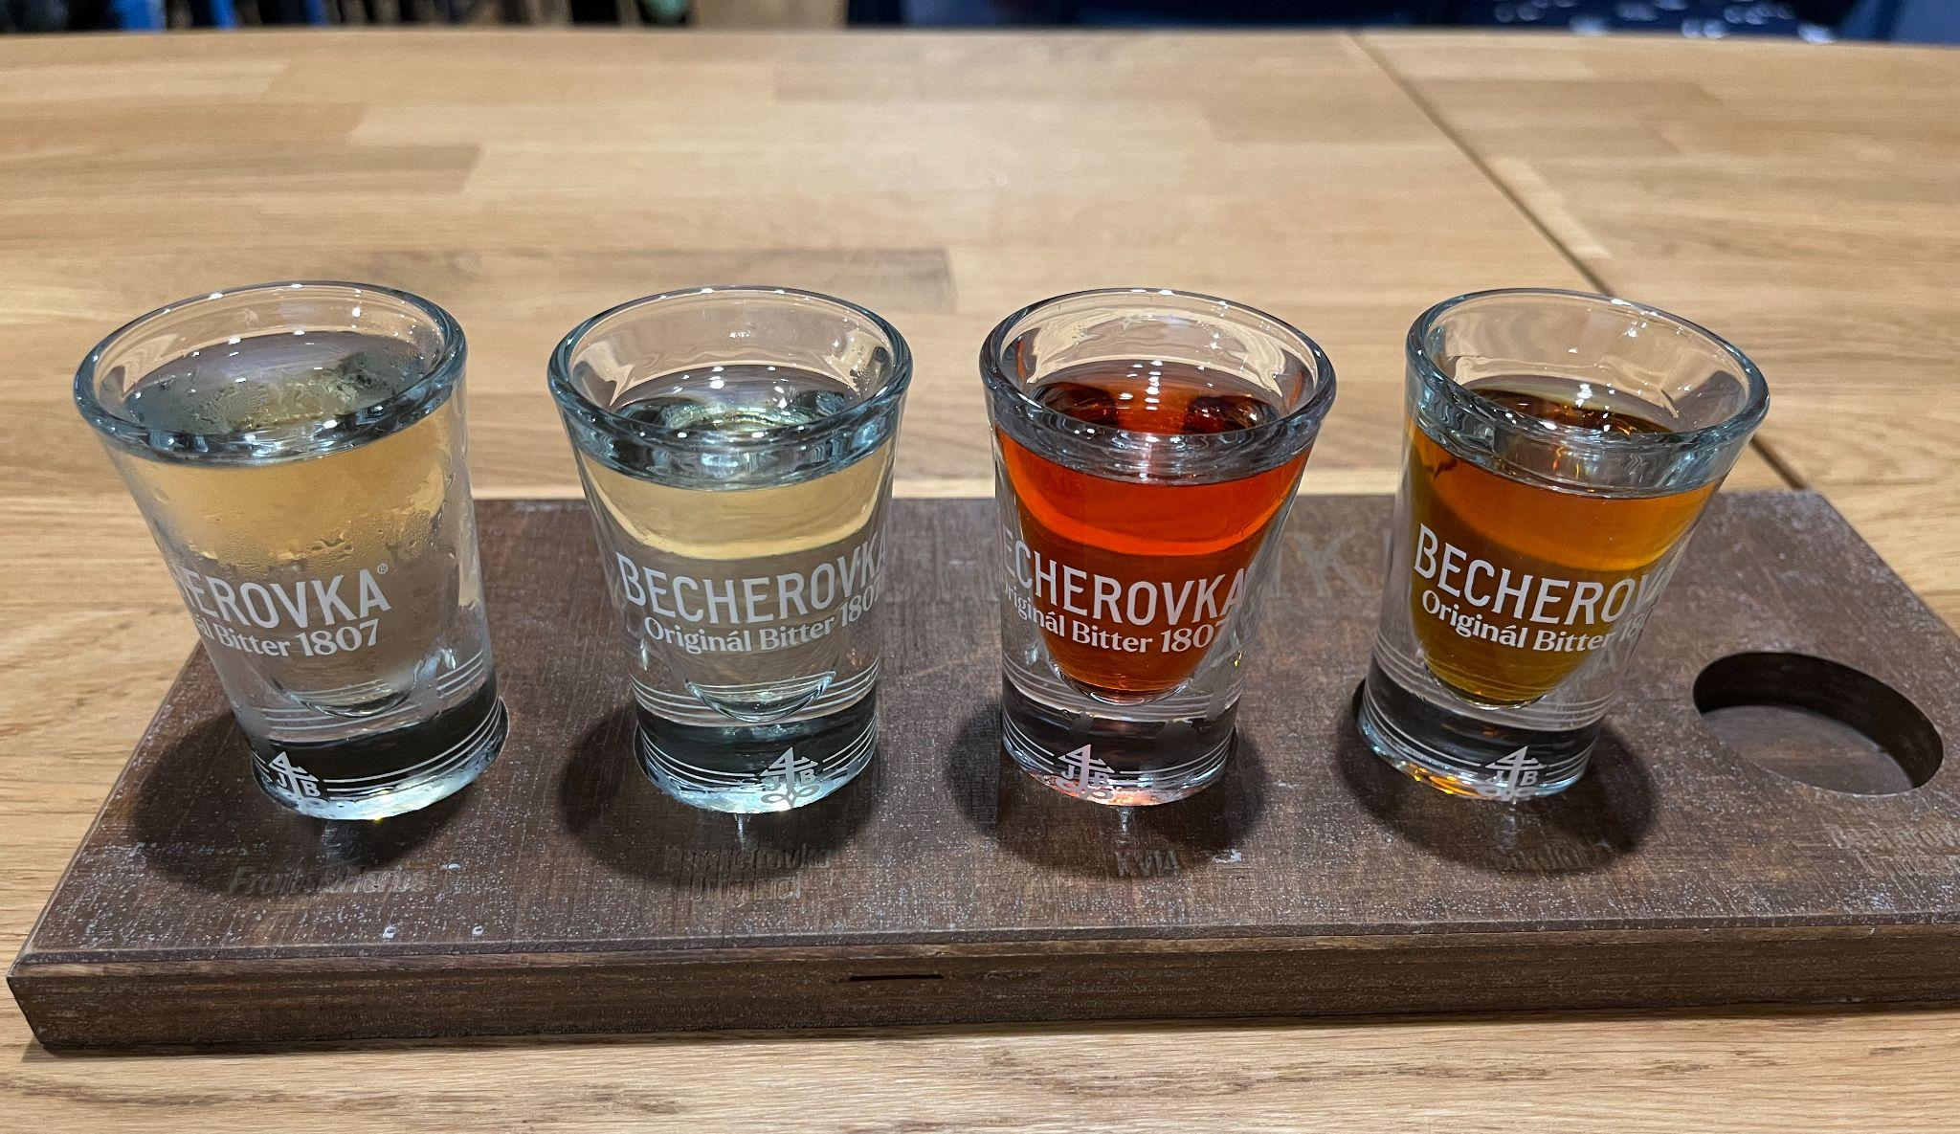
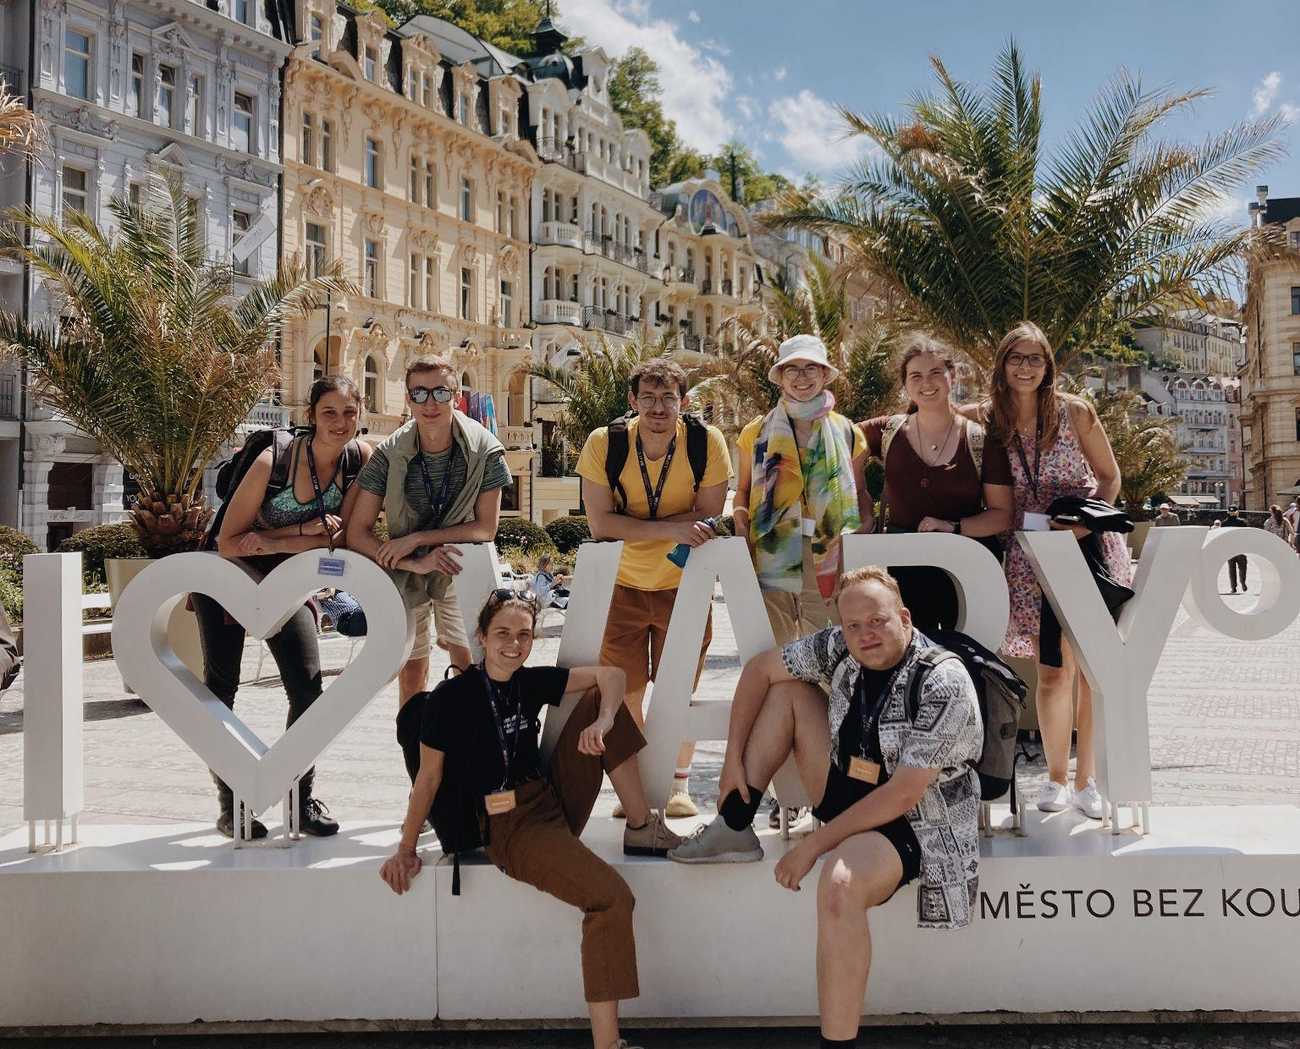
What did we like…

