Slide 1
Postgraduate education among countries:
Finland, Greece & Czech
Students: Juvonen Wilppu, Miteloudis Garyfallos, Pekkala Salla, Sampazioti Dimitra, Lefa Eva

Slide 2
For Master’s Degree/ Program
 | FINLAND | GREECE | CZECH
Duration | Master of healtcare : 2-3 years, 90 credits, part time studies​ Master of physiotherapy and healthcare sciences: 2 years, 120 credits, full time studies​ | Advanced physiotherapy: 1,5 or 3 years depending on how many courses you have in each semester | Applied physiotherapy: 2 years Some universities in Czech Republic offer part time studies, credits differ​
Price | Both free of charge | Costs | Free until 26 years old
Requirements of getting in | Both have entrance exam Master of healthcare you need 2 years of work experience after the bachelor’s degree​ | No entrance exam You do not need any experience You can go right after the Bachelors degree | Entrance exam You do not need any experience, You can go right after the Bachelors degree
Content of studies | Both can be general or specialized through your own choice of courses. | General | General

Slide 3
For Ph D. Degree/ Program
 | FINLAND | GREECE | CZECH
Duration | Doctor of healthcare sciences : 4 years 45-60 credits , part time studying | Ph D. of University of Thessaly: 3 years | Kinesiology and rehabilitation: 4 years You can also do it part time and in English on the 2nd faculty of medicine​
Price | Free of charge | Free of charge | Free of charge
Requirements of getting in | You have to apply and know the theme of the doctoral thesis | Teaching experience, being research active and complete your doctoral thesis | Writing a dissertation thesis, which you have to present in front of comity Have knowledge about kinesikinesiology and rehabilitation Previous activity in physiotherapy field
Content of studies | General or specialized through your own choice of doctoral thesis | General or specialized through your own choice of doctoral thesis | Not specialized

Slide 4
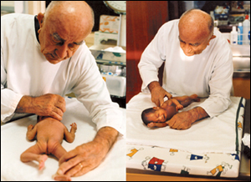
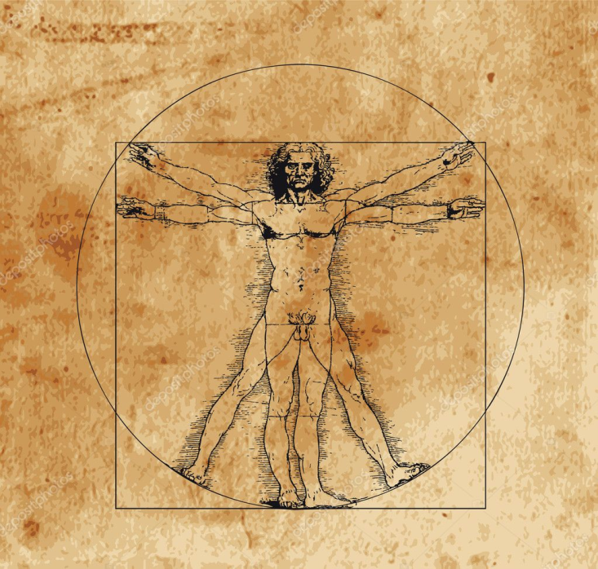
THANK YOU

