Slide 1
Who are the prominent personalities in rehabilitation and physiotherapy and what is their influence on the development of rehabilitation/physiotherapy practices in different countries
Holanová Pavlína
Kivimäki Arttu
Rendl Michael
Roussi Eleftheria
Sina Suela
Group 4

Slide 2
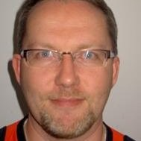
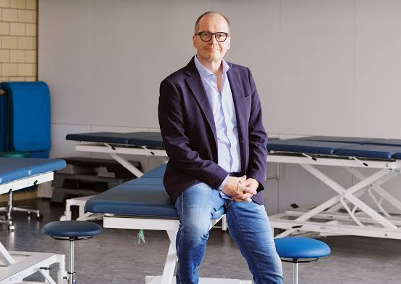
Finland
Hannu Luomajoki
OMT-therapist
Professor of Musculoskeletal physiotherapy master’s program in the University of Zürich, Switzerland since 2011
Associate professor of sports science faculty in the University of Jyväskylä
Achievements:
2008 Prestige of research (?) in the Switzerland
2014 Physiotherapist of the year in Finland
2018 Finland’s golden medallion of clinical work and research of pain in physiotherapy
Written 13 books in different fields physiology and pain

Slide 3
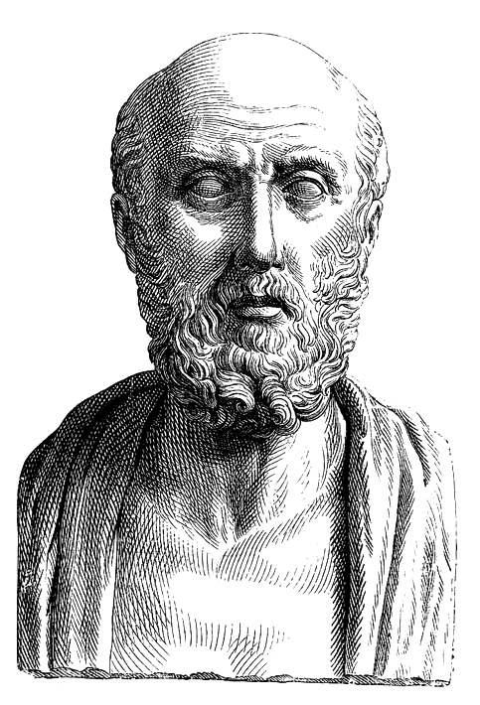
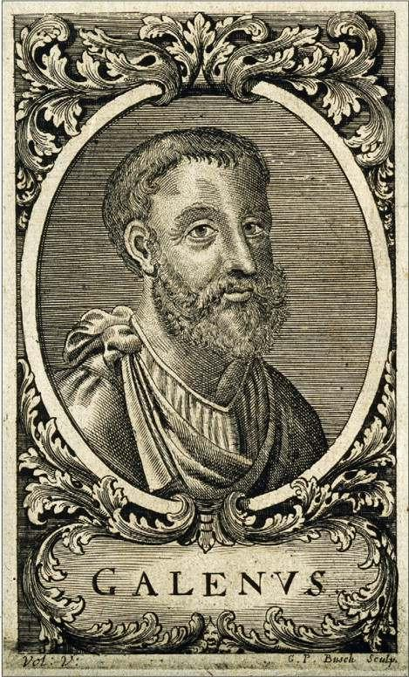
Greece
HIPPOCRATES
“Father of Medicine”
460-370 BC
Use of massage and manual therapy techniques
GALEN
129-216 AD
Detailed descriptions of the musculoskeletal system and understanding of muscle function
Use of massage and manual therapy techniques

Slide 4
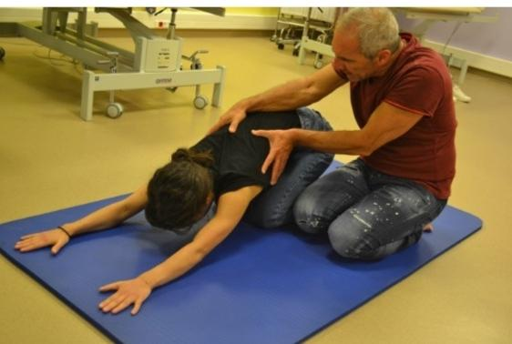
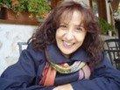
Greece
ATHINA GEORGIADOU
MAUROMOUSTAKOS SAVVAS
Senior instructor of bobath
Instructor of Sensory Integration and PNF
Specialized in Pediatric physiotherapy
Organizator of many courses and workshops of NDT-Bobath and baby NDT-Bobath
PNF instructor
Trained in Manual Therapy Techniques, Mackenzie, Mulligan, Motor Learning and Motor Control
Specialized in rehabilitation of amputees and hemiplegic patients and idiopathic skoliosis

Slide 5
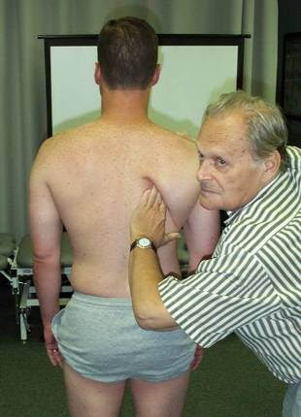
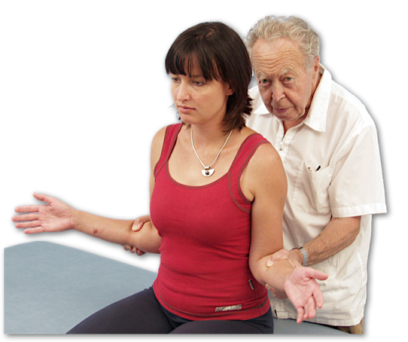
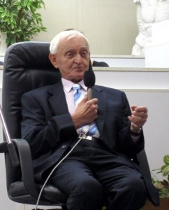
Czech Republic
Prof. MUDr. Karel Lewit DrSc.
Prague Myoskeletal school, manipulation therapy
Prof. MUDr. Vladimír Janda DrSc
Prague Myoskeletal school and had a big impact on founding Physiotherapy department at 3.LF
Vertebrogenic dysfunctions, Muscle strength test, Cross-section syndrome
Doc. MUDr. František Velé CSc.
Prague Myoskeletal school
Kinesiology and Neurological rehabilitation

Slide 6
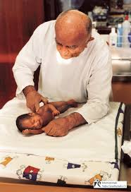
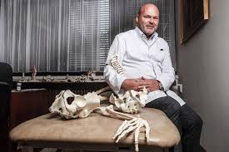
Czech Republic
Prof. MUDr. Václav Vojta DrSc.
Principles of Reflex Locomotion for children with cerebral Palsy
Prof. PaedDr. Pavel Kolář PhD.
Dynamic Neuromuscular Stabilisation

Slide 7
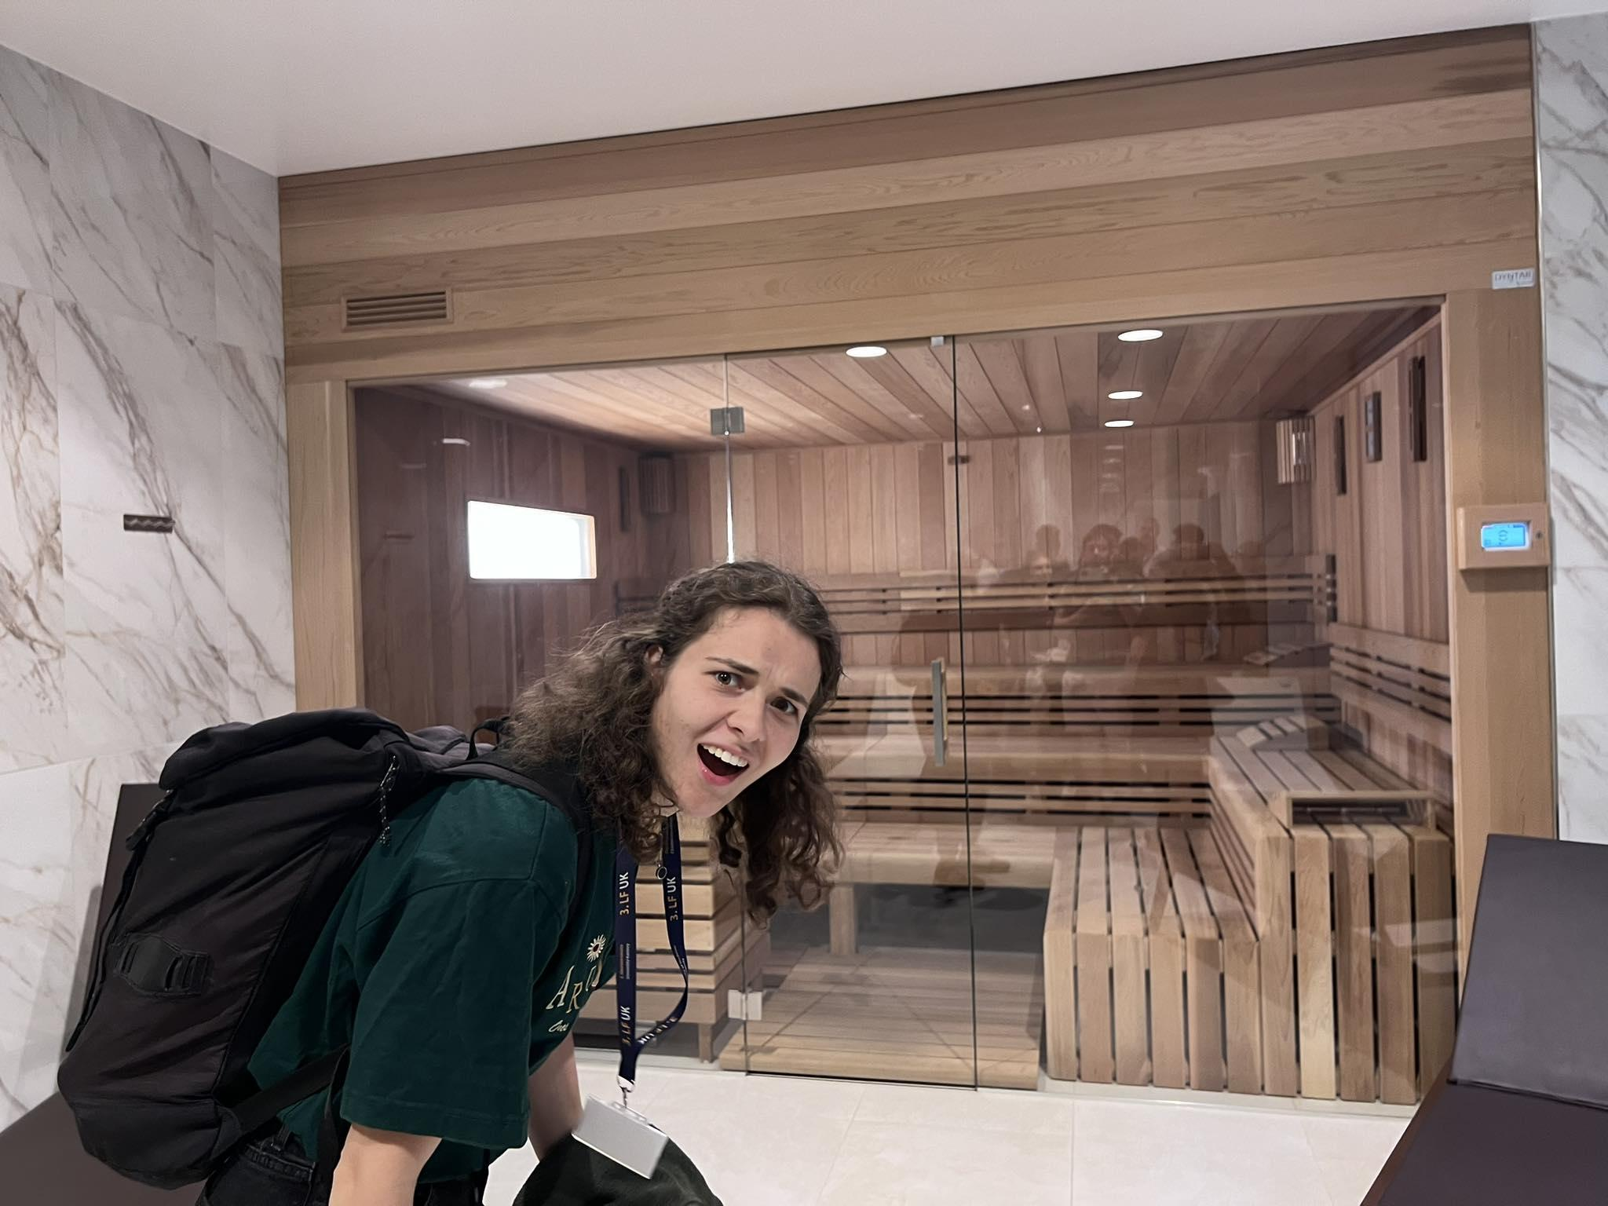
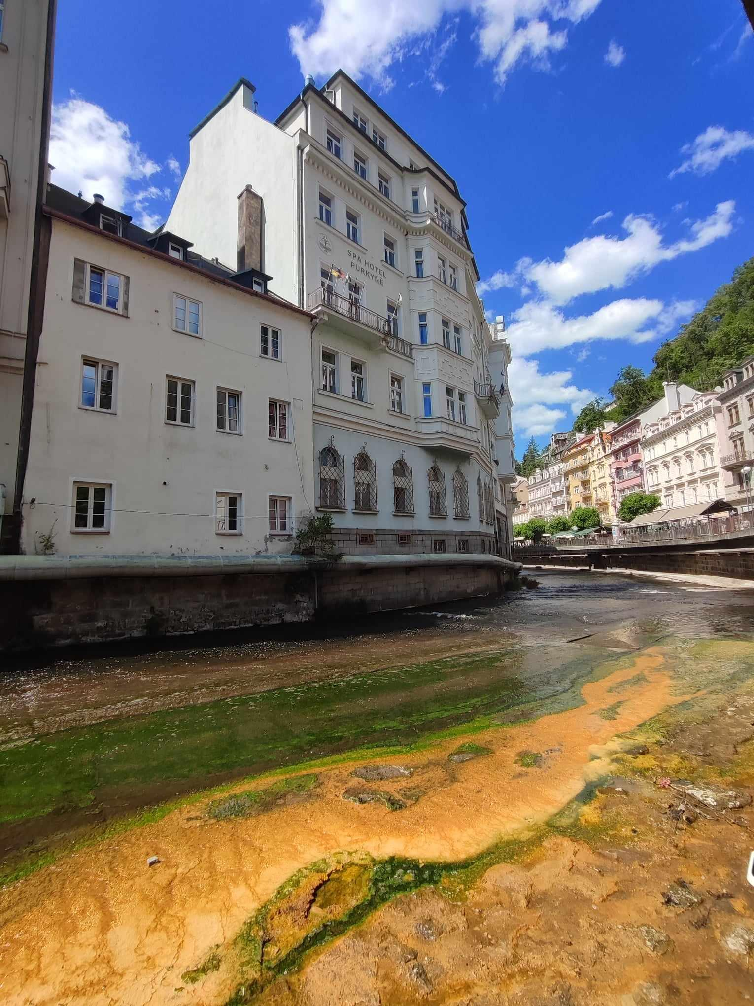
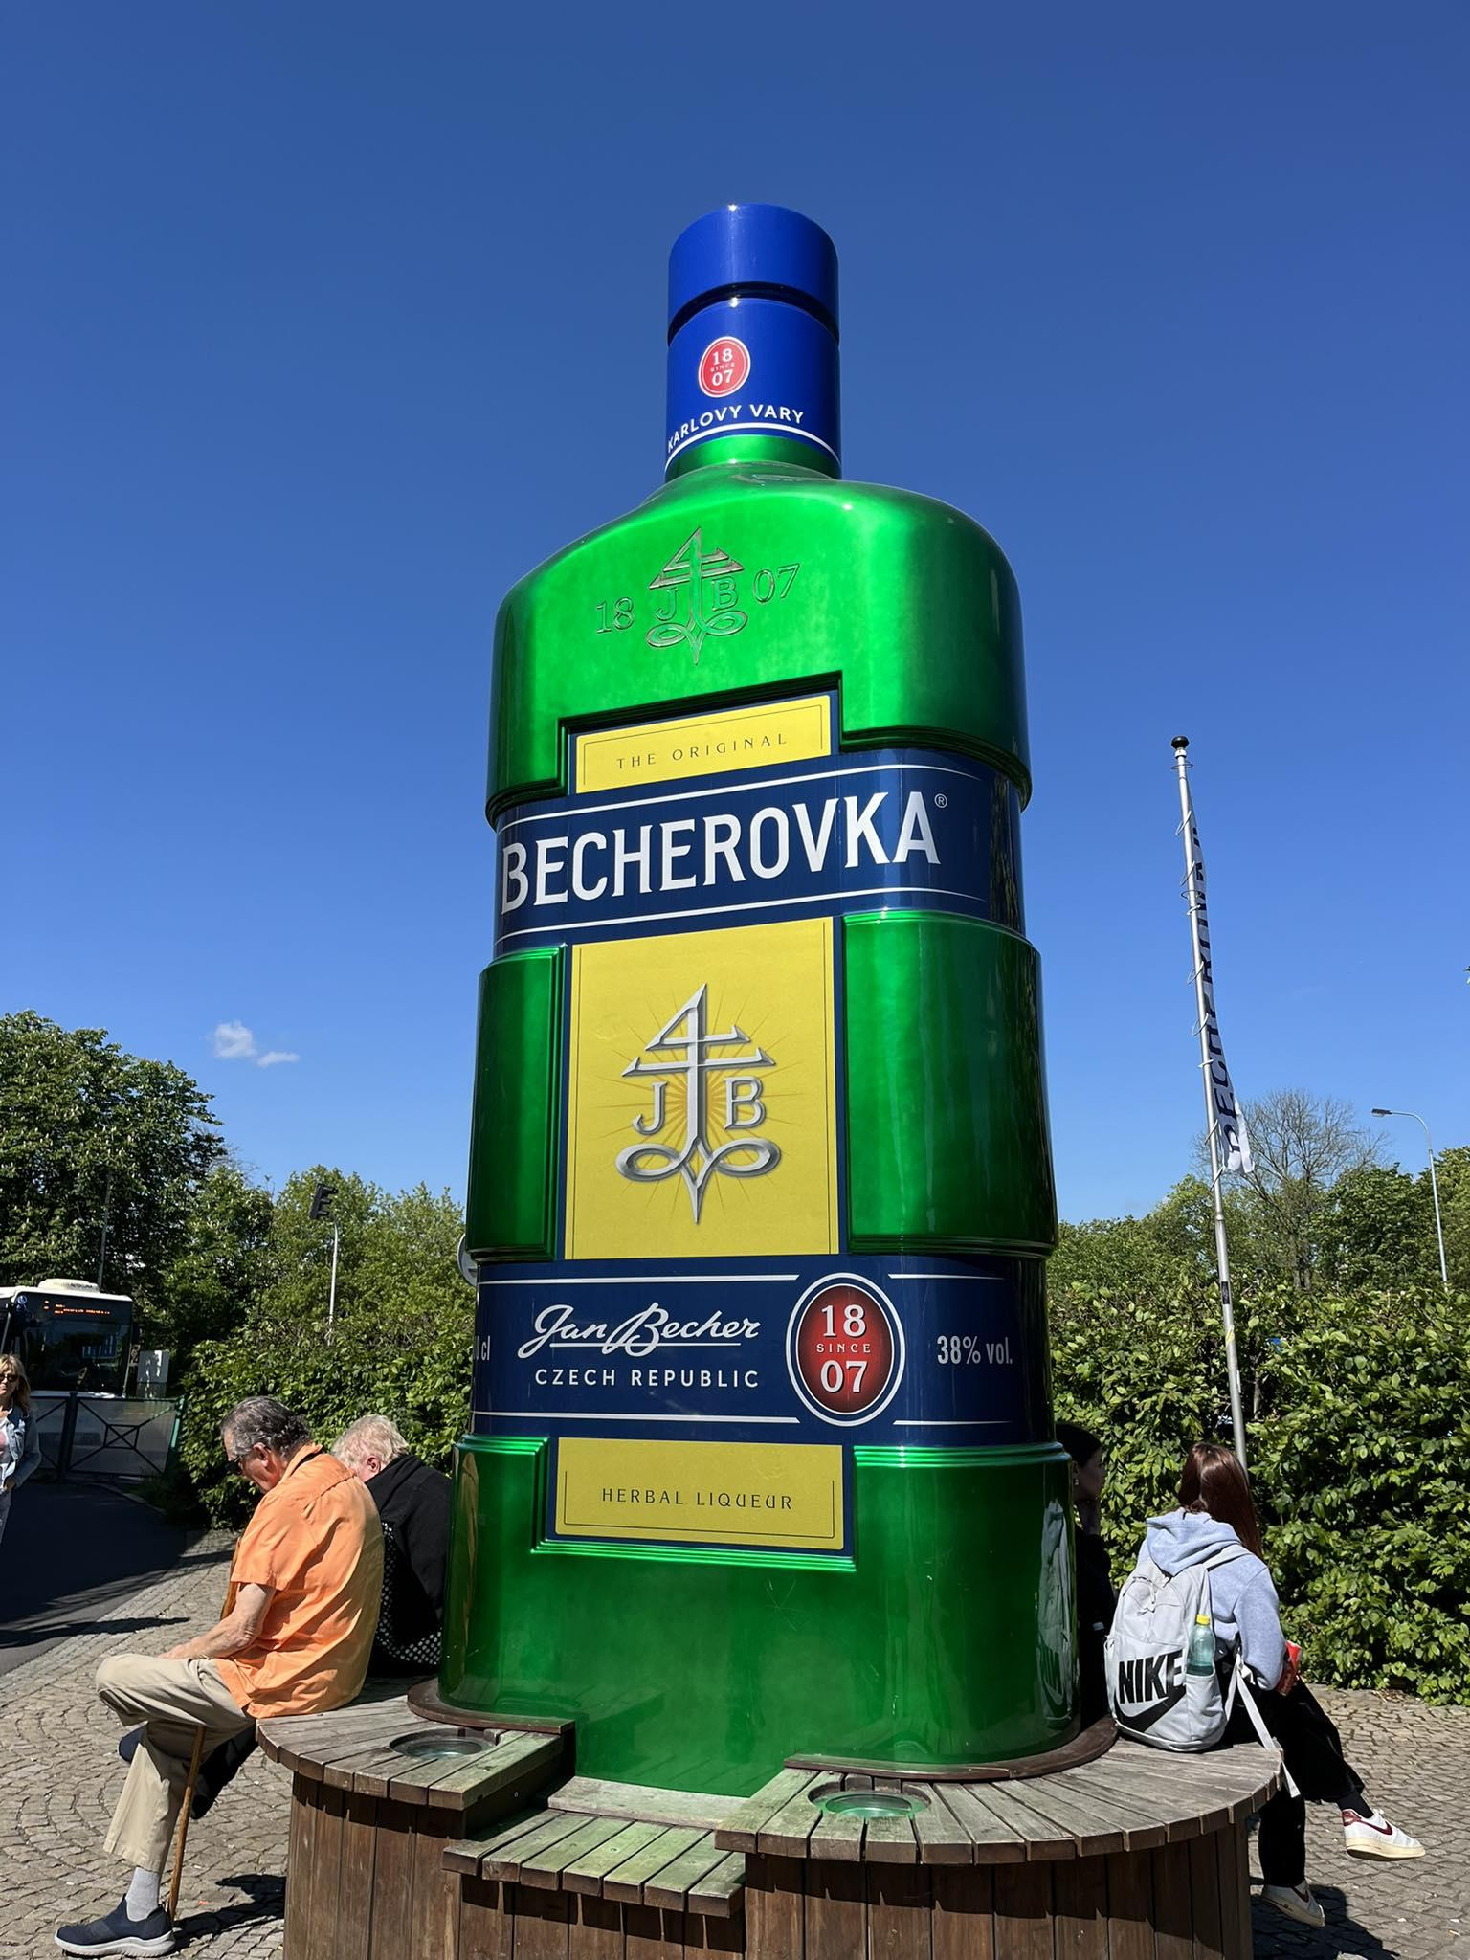
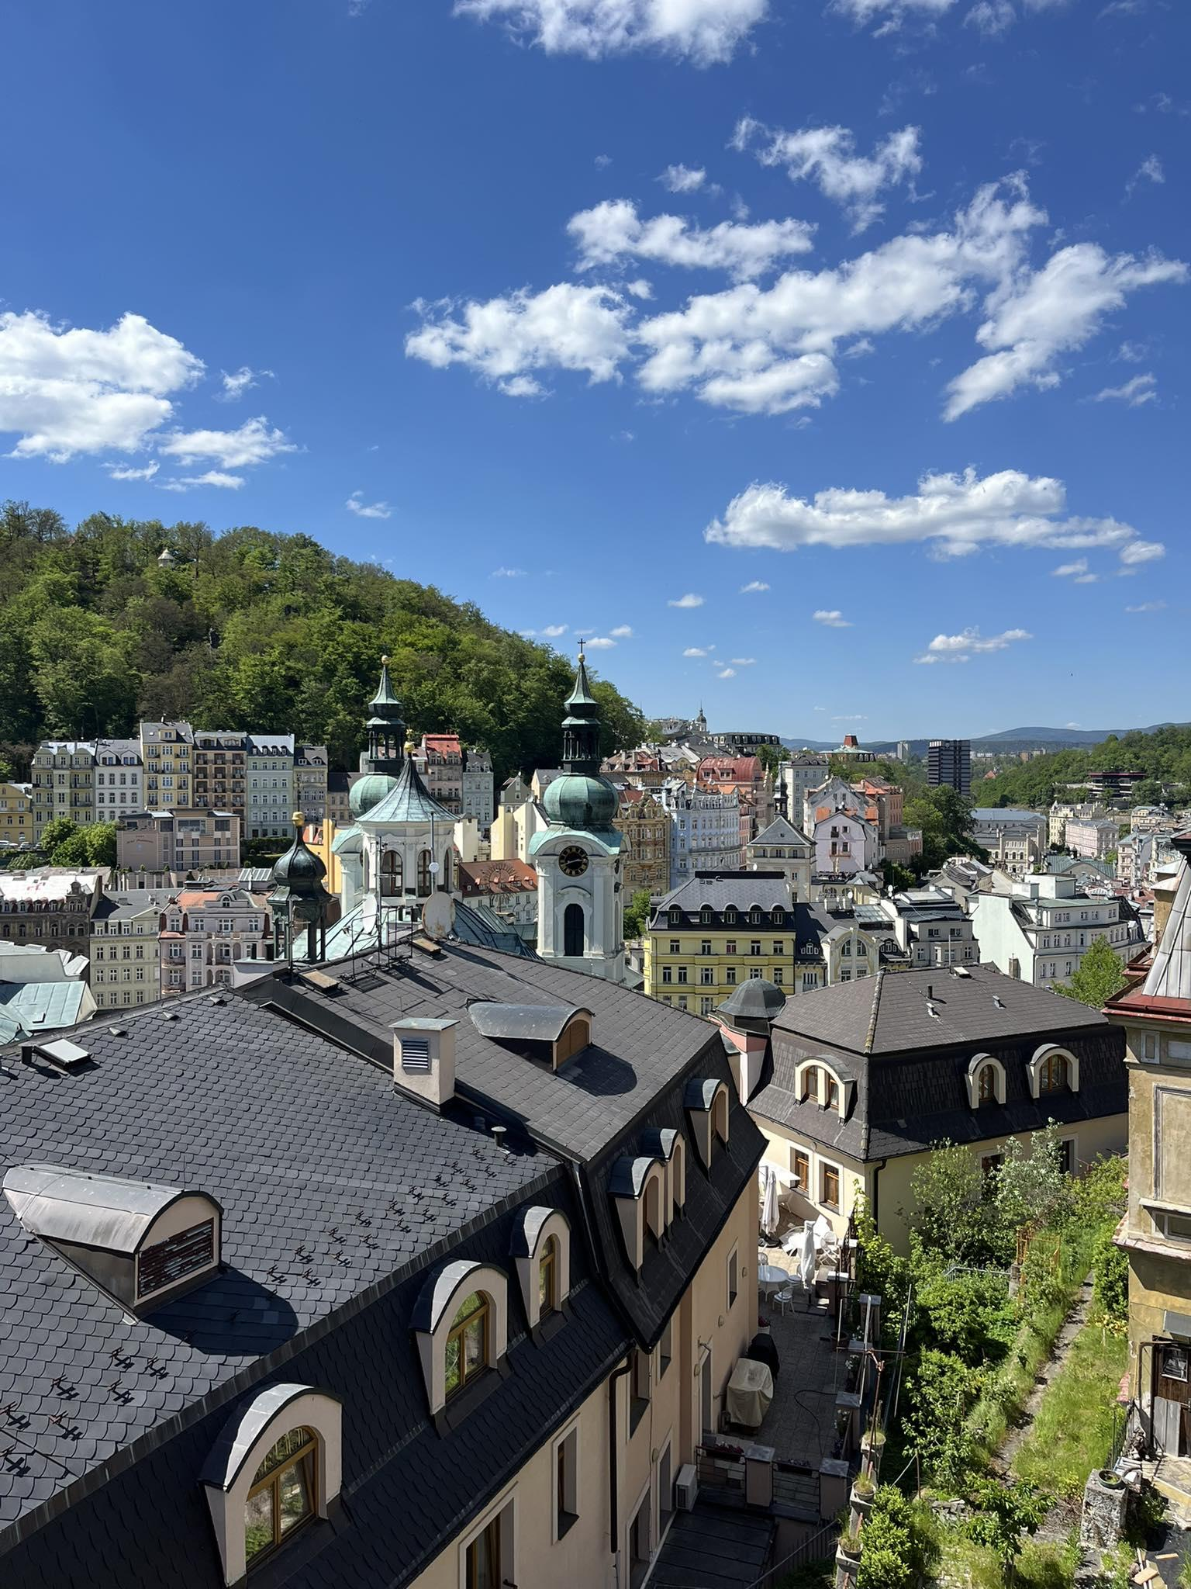
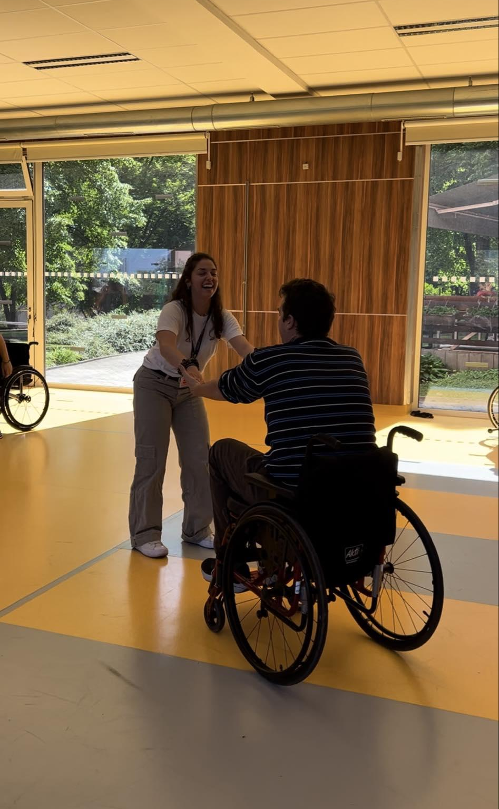
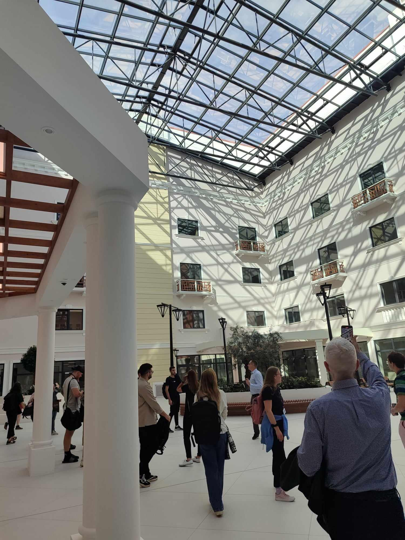
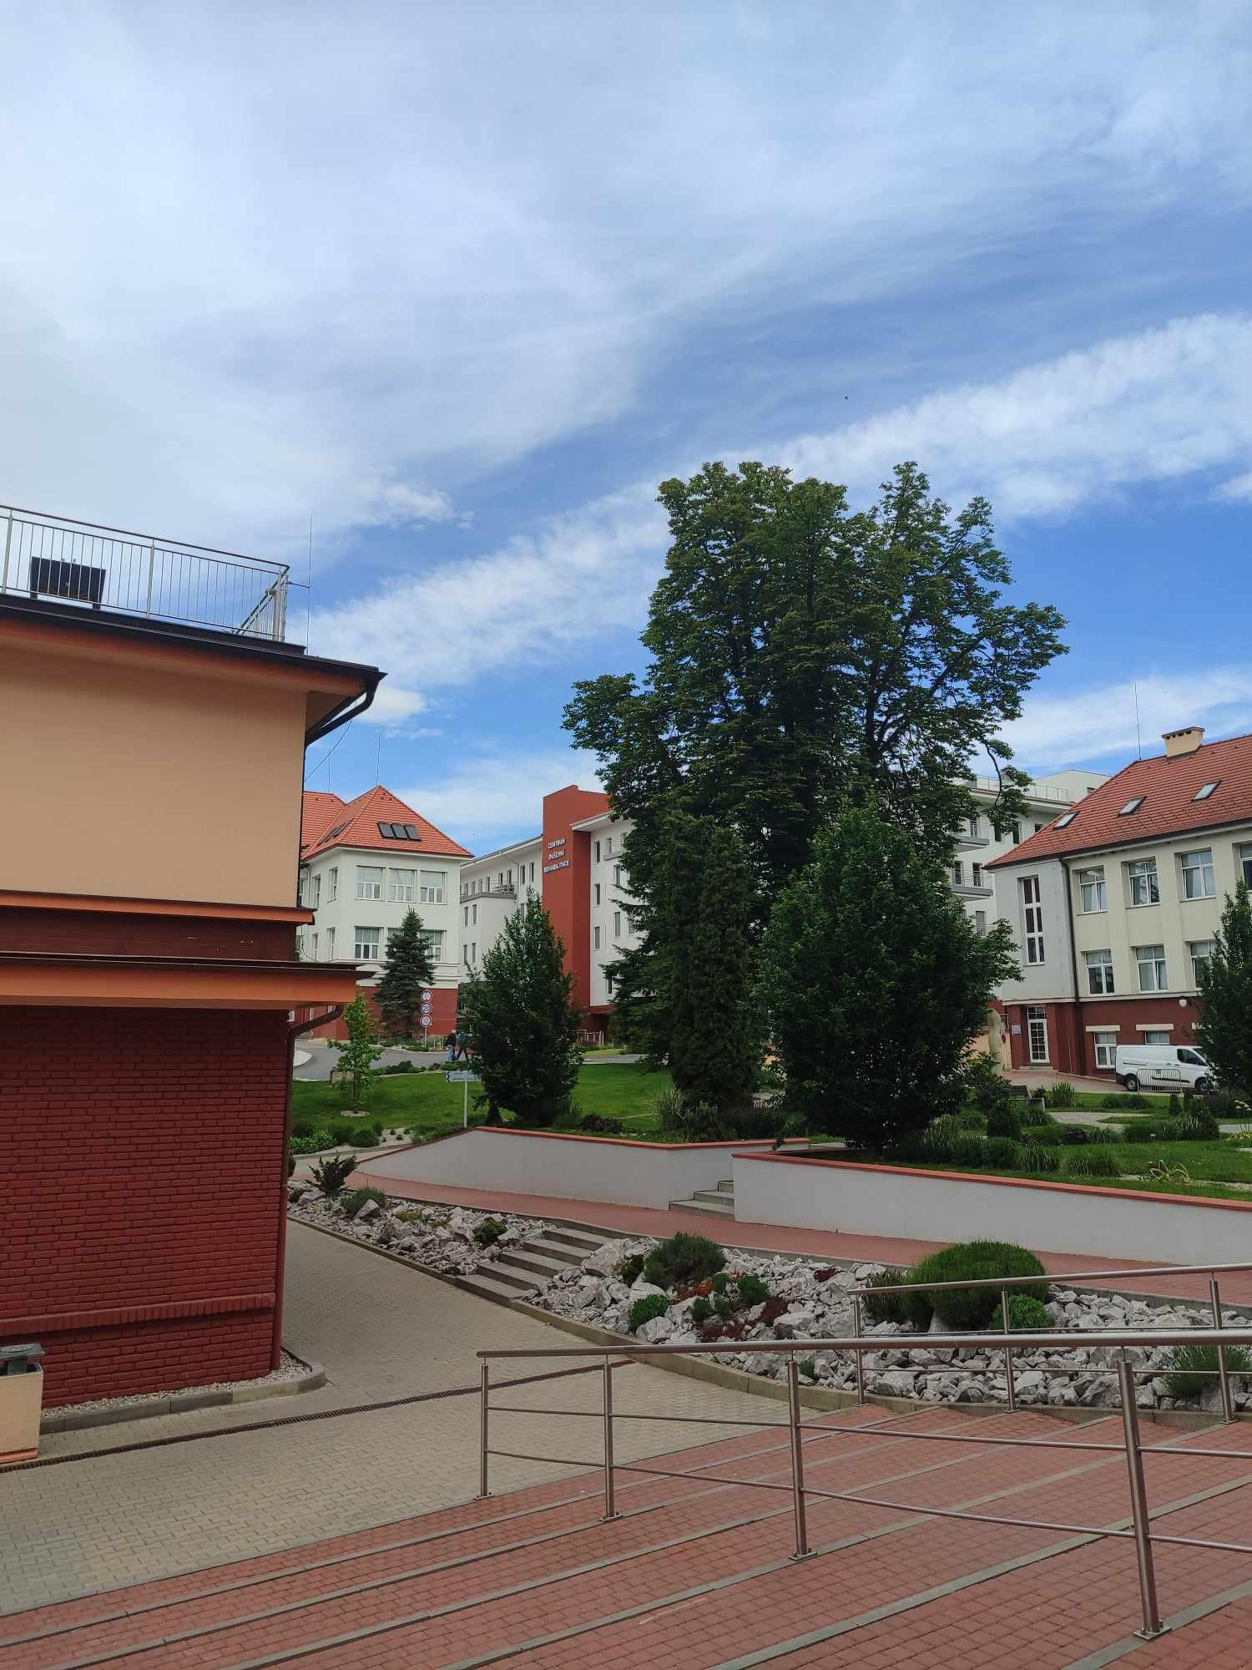
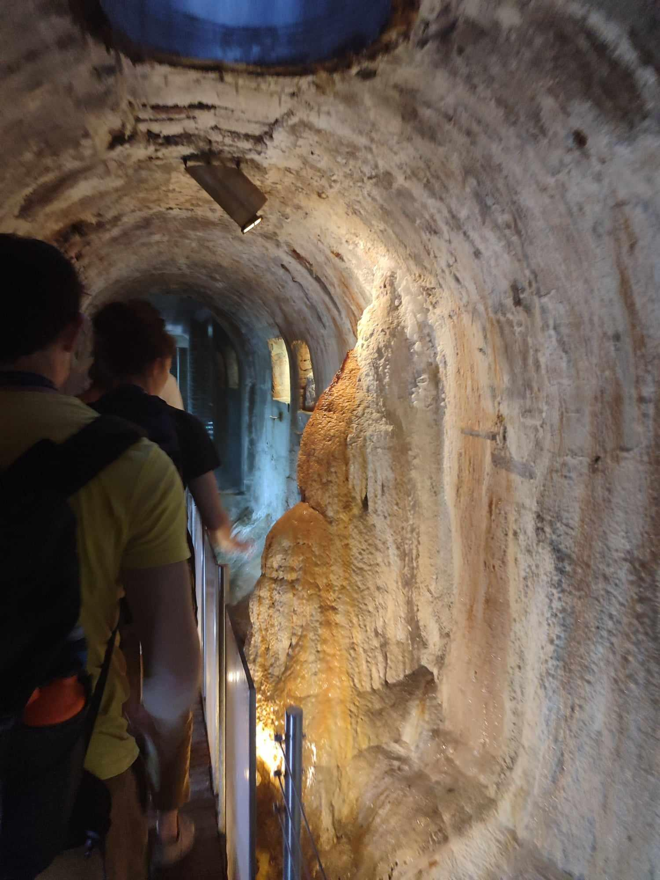
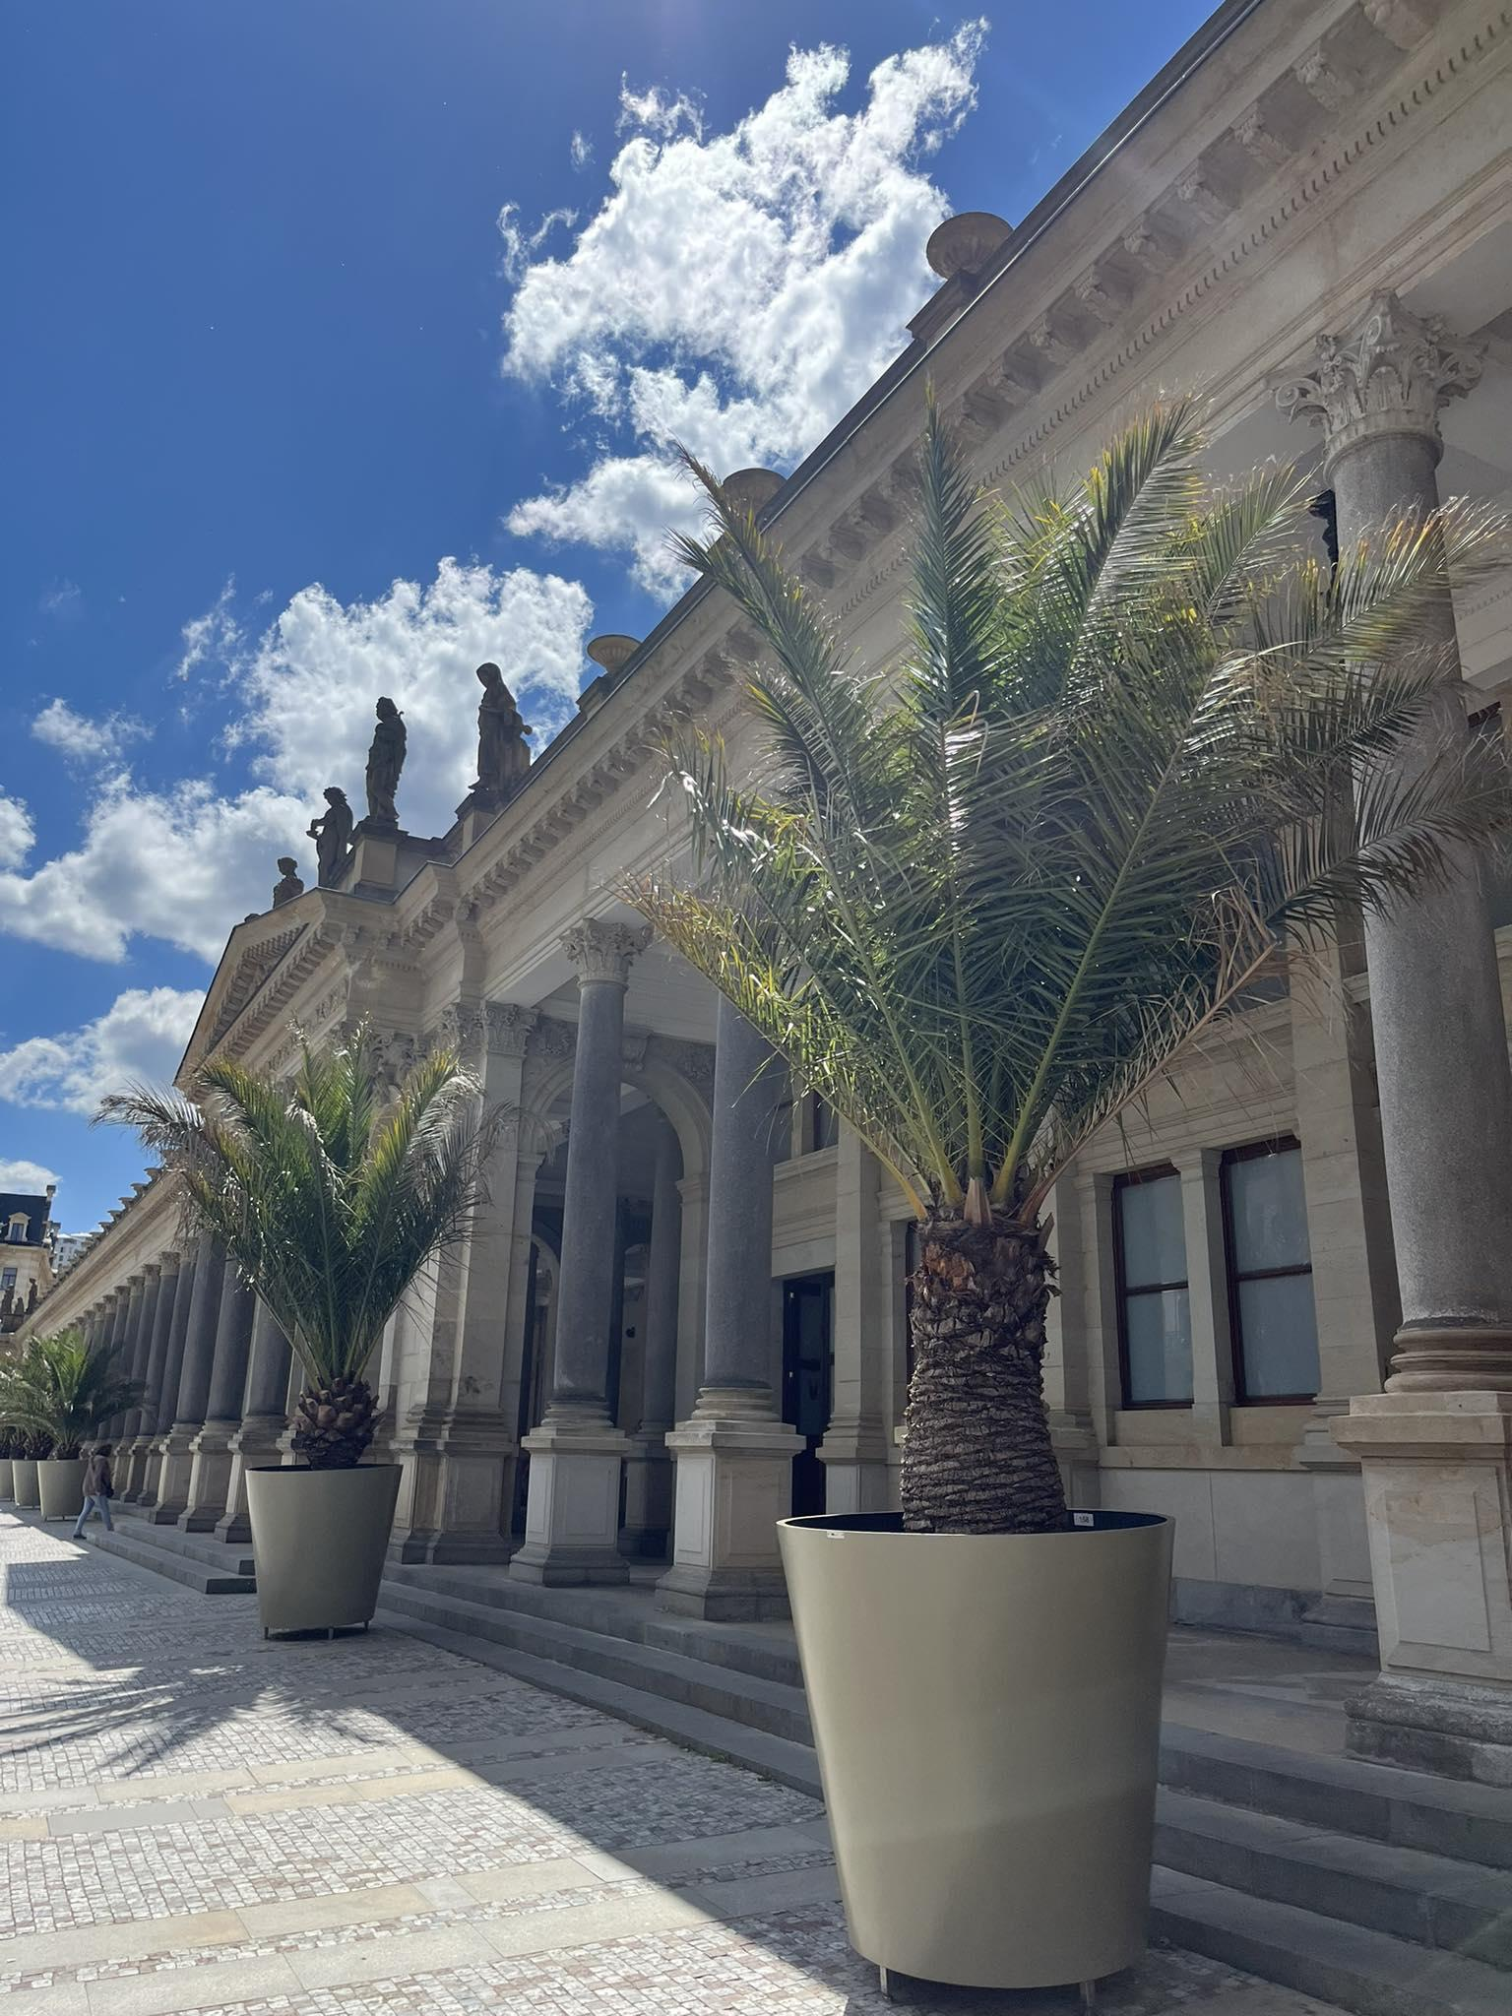
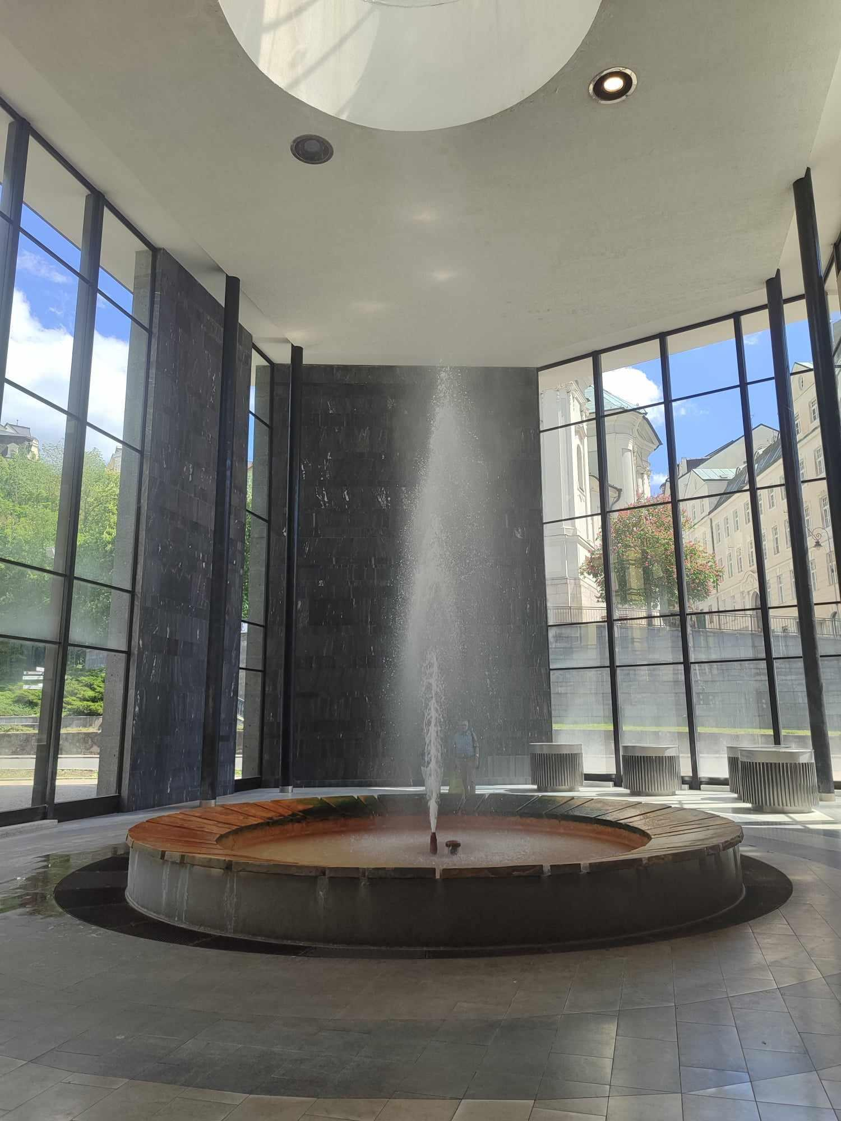
Experiences we found interesting

