Slide 1
Quality of Life and Quality of Education among Physiotherapy Students in Europe
Michaela Schramlová, BCs.
3rd and 2nd Faculty of Medicine, Charles University

Slide 2
Motivations:

Slide 3
1. Small number of studies on physiotherapy students
2. Small number of studies correlating - mental well-being with the educational system
Different educational systems (bachelor VS academic master)
-> different Health Systems and Policies with different impact on used rehabilitation and physiotherapy approaches and methods
3. Differences between universities in Europe?

Slide 4
pilot project - 2020

Slide 5
Desriptive, cross-sectinal study, 3/2021 (summer semester)
3 universities:
Savonia University of Applied Sciences, Kuopio -> Marja Aijo
University of Milan -> Johanna Jonsdottir
Charles University -> Kamila Řasová
Comprehensively describe and compare the physiotherapy students and educational systems
-> Create the questionnaires, in English
For students (1st-3rd year of bachelor degree programme) -> online (QoL, QoE) – online via SURVIO.cz
For guarantors (basic information about university/faculty and students, teaching of specific physiotherapy methods) – Word document

Slide 6
Quality of life
Mental health (USOS questionnaire and WHOQOL-BREF)
Sleep quality (PSQI)
Physical activity (IPAQ-SHORT + METs units)
Nutrition (Mini-ECCA version 2. + WHO – Food-Based Dietary Gudeline for Europe, 2021 + komPAN questionnaire)
Paid job
+ COVID-19 section in each part
Quality of Education
Time-challenging education, subjective satisfaction + COVID-19 part
Knowledge of specific methods

Slide 7
Results:

Slide 8
48,3% - worse quality of sleep
50% - high or extreme stress load, mainly form academic stressors
Only 36,7% - high intensity physical activity
Consumption of fruits and vegetables -> 5 portions a day -> only 28,3% (the best in Kuopio)

Slide 9
The grates limitation -> not enough participants
60 respondents
46 = CZ
8 = FINLAND
6 = ITALY

Slide 10
Project n2. 2022-2023

Slide 11
Adjust the questionnaire
Elimination of COVID 19 sections
shorter parts (50->20mins)
nutrition questions, paid job
Both questionnaires in online version -> SURVIO.cz
Online meeting with guarantors to educate how to collect data
Distributed via online link to guarantors and students

Slide 12
Results:

Slide 14
Charles University – 2nd Medical Faculty, Prague, Czechia | Faculty of Health and Caring Professions, University of West Attica, Greece
Charles University – 3rd Medical Faculty, Prague, Czechia | University of Patras, Greece
Univerzita Palackého, Olomouc, Czechia | University of Peloponnese, Greece
České vysoké učení technické, Fakulta biomedicínského inženýrství, Kladno, Czechia | University of Thessaly, Greece
Univerzita Karlova, Fakulta tělovýchovy a sportu, Prague, Czechia | University of Sassari, Sassari, Italy
Oulu University of Applied Sciences, Oulu, Finland | University of Milano, Milano, Italy
Satakunta University of Applied Sciences, Satakunta, Finland | Univerzita sv. Cyrila a Metoděje, Trnava, Slovakia
Savonia University of Applied Sciences, Kuopio, Finland | Slovenská Zdravotnická Univerzita, Fakulty ošetřovatelství a zdravotnických odborných studií, Bratislava, Slovakia
Tampere University of Applied Sciences, Tampere, Finland | Univerzita Pavla Jozefa Šafáříka, Košice, Slovakia
Universum College, Pristina, Kosovo | University of Valencia, Valencie, Spain
University of Patras, ŘeckoPolitéchnico de Leiria, Leiria, Portugal | University of Salamanca, Salamanca, Spain

Slide 15
7 semesters - Finland, 8 semesters – Greece + Spain + Portugal
Slovakia has combined form, others had present form of study
Number of students – Kosovo (45), Trnava (SK) (510)
Student fees (Kosovo, Salamanca, Trnava, Milan, Sassari, Leiria) 500-4400 euro, except Leiria others have scholarship
11 universities DO NOT HAVE compulsory summer traineeship

Slide 16
75 % evaluated positively their quality of life
47 % were satisfied with their mental health
65 % showed higher stress levels – the most stressful were academic factors
70,5 % had worsened sleep quality
78,9 % engaged in min 150min of Physical activity/week, (30min only 51%), 30% HEPA
Worse mental health = worse sleep quality and lower activity
Overall, the worst results were for females

Slide 17
The best
Finland - USOS, sleep quality + physical activity
Kosovo – subjective evaluation of mental health, the best communication and organization of the study programme
The worst
Italy – mental health, Physical activity, organization and communication of study programme
Portugal -> Physical activity + sleep quality + USOS
Greece -> sleep quality + USOS
Overall – nutrition habits -> 10 % = 2 portions of fruit + 3 portions of vegetables, the best Italy and Spain, there also the lowest BMI and weight

Slide 18
Comparison PILOT and CURRENT study
50% VS 65% - high or extreme stress load, mainly form academic stressors
48,3% VS 70,5% - worse quality of sleep
Only 36,7% VS 30% in HEPA
Only 28,30 VS 10% - 5 portions (fruits and vegetables)

Slide 19
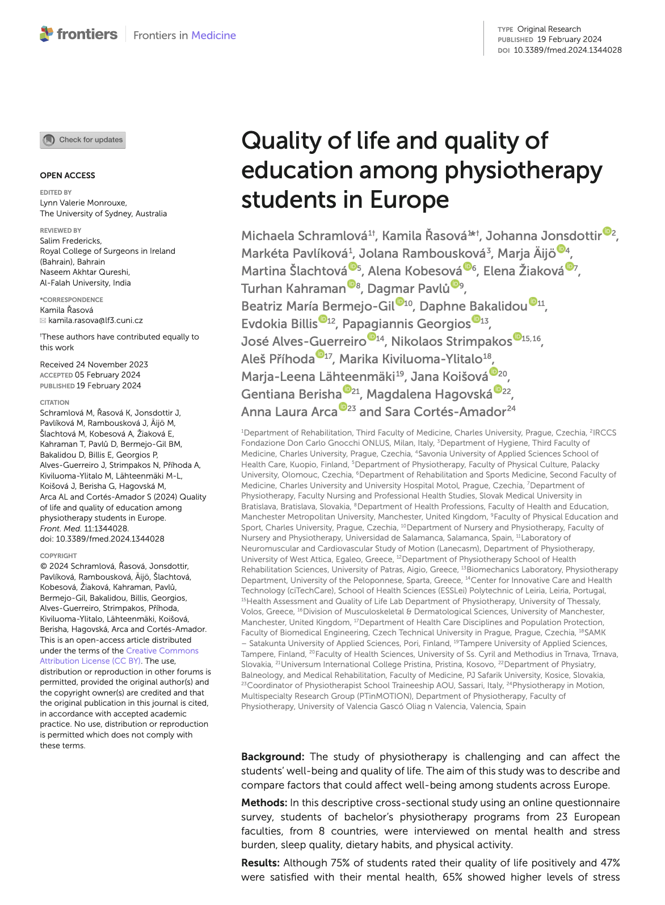
What next?
Working on analyzing the current data, to get more detailed answers.
Also, we published summarized rural data in 2/2024 in Frontiers

Slide 20
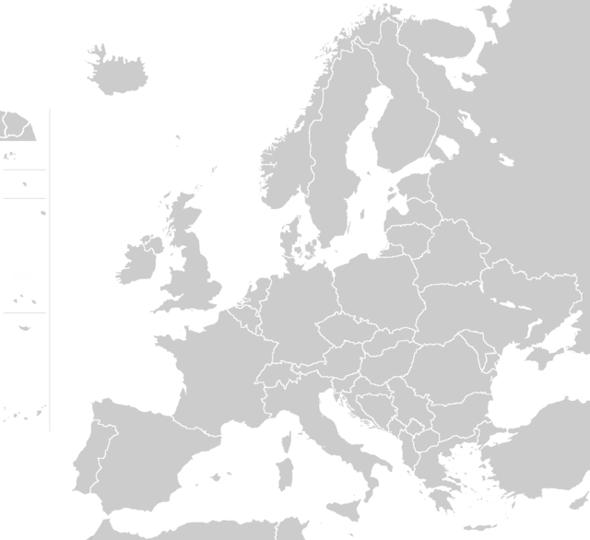
Oulu University of AS
Pavel Josef Šafářik University
Satakunta University of AS
Saint Cyril and Methodius University
Tampere University of AS
Slovak Medical University
Savonia University of AS
Universum College, Kosovo
Palacký University
University of Peloponnese
Charles University (4)
University of Thessaly
University of Patras
University of Milan
University of West Attica
University Sassari
Politécnico de Leiria
University of Salamanca
University of Valencia

