Slide 1
The differences in healthcare organization/ healthcare systems among countries
Participants:
Janečková Tereza
Sopka Marek
Kalogeraki Chrysoula Maria
Lioliopoulos Vasileios

Slide 2
Greek healthcare system
Healthcare in Greece consists of a universal health care system provided through national health insurance, and private health care.
Healthcare in Greece is provided by the National Healthcare Service, or ESY.

Slide 3
Czech healthcare system
The Czech Republic has a universal health care system, based on a compulsory insurance model, with fee-for-service care funded by mandatory employment-related insurance plans since 1992.

Slide 4
Primary health care in Greece
In Greece, the leaders in Primary Care Health are the Health Centers whose role is the prevention of illness and the promotion of health in general, and the assessment of emergencies. It also includes public hospital outpatient departments. Other public primary healthcare is provided through health centers operated by social insurance funds, local authorities and municipalities.

Slide 5
Primary health care in the Czech Republic
Medicare includes:
maternal and child care,
gynecology,
dentistry,
home care by nurses,
24 hour emergency cover,
preventive services such as immunization or screening.

Slide 6
People who work and live in Greece must get a social security number, ΑΜΚΑ. Their employer has to make contributions on their behalf and arrange a health care provider for them.
The private healthcare sector is also extensive and includes doctors in private practice who are under contract with one or more insurance funds. Private medical facilities are generally less affected by the country’s economic situation and have better facilities with newer equipment.

Slide 7
Public health care in the Czech Republic
Private health care in the Czech Republic
Mandatory health insurance contributions from employers and employees. Public sector is more extensive than the private one.
Private ambulances are usually better equipped and offers shorter waiting times but more expensive. It is paid by the patient himself or from private insurance.

Slide 8
Rehabilitation after hospitalization in Greece
After hospitalization, the patient can choose between home rehabilitation and rehabilitation in a specialized center. Depending on the patient’s health insurance a specific amount of money is provided.

Slide 9
Rehabilitation after hospitalization in the Czech Republic
The rehabilitation must be prescribed by physician to be paid by a health insurance company
Stay in spa can be also paid by a health insurance company –
multiple sclerosis once per year for 4 weeks
adults with cerebral palsy 4 weeks once per two years

Slide 10
Please let us know about Finland's healthcare system!

Slide 11
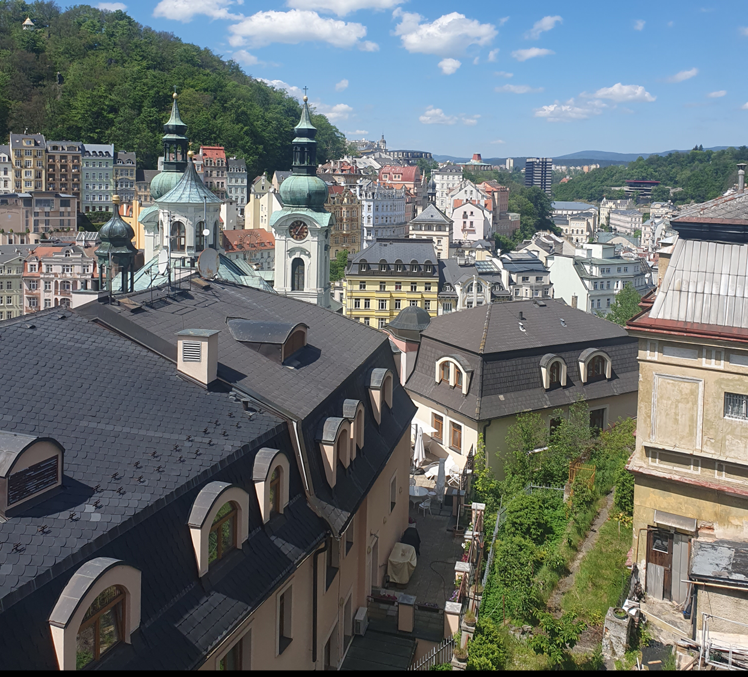
Karlovy Vary

Slide 12
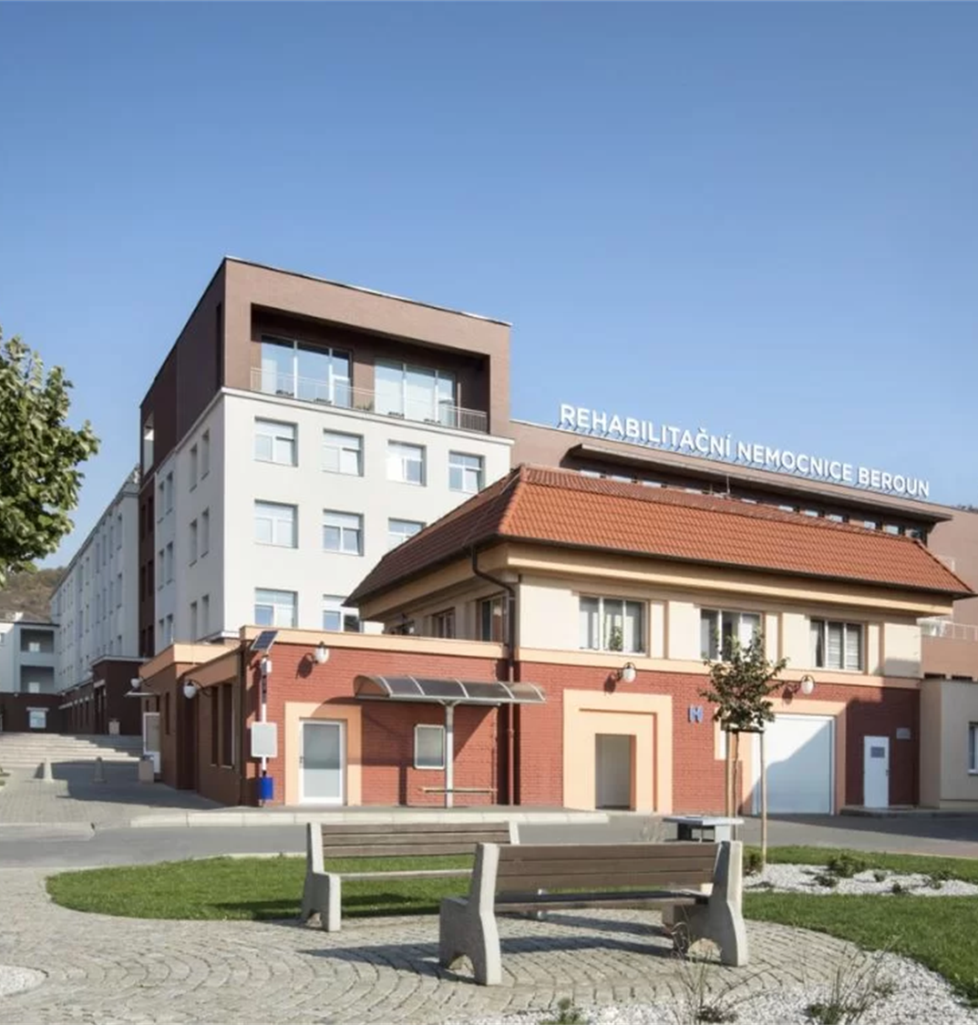
Beroun Hospital

Slide 13
Thank you for your attention!

